Slide 1
IRUS-UK
Making scholarly statistics count in UK repositories
Paul Needham, Cranfield University
10th July 2012

Slide 2
IRUS-UK
Funded by JISC as part of UK RepositoryNet+
Lead by Mimas
Primary Project Team Members:
Mimas
Cranfield University
EvidenceBase, BCU
IRUS: Institutional Repository Usage Statistics

Slide 3
IRUS-UK: history
Emerged as an outcome of PIRUS2
Publisher and Institution Repository Usage Statistics project
Aimed to develop a global standard to enable the recording, reporting and consolidation of online usage statistics for individual journal articles hosted by Institutional Repositories, Publishers and others
Proved it was technically feasible, but thwarted by organisational and political issues
However, crisis/opportunity… we now knew it was possible to…

Slide 4
IRUS-UK: aim
Enable UK IRs to share/expose usage statistics based on a global standard – COUNTER
Produced on the same basis as publishers
Filtered to remove robots and double clicks
Comparable
Reliable
Trustworthy
Authoritative

Slide 5
IRUS-UK: objectives
Collect raw usage data from UK IRs for all item types within repositories
Downloads not record views
Process those raw data into COUNTER-compliant statistics
Return those statistics back to the originating repositories for their own use

Slide 6
IRUS-UK: objectives
Give JISC (and others) a nation-wide picture of the overall use of UK repositories
demonstrate their value and place in the dissemination of scholarly outputs
Offer opportunities for benchmarking
Act as an intermediary between UK repositories and other agencies
e.g. global central clearinghouse, national shared services, OpenAIRE

Slide 7
IRUS-UK: gathering data
Considered 2 scenarios for gathering data
‘Tracker’ code
a server-side ‘Google Analytics’ for item downloads
Pushes metadata to a third-party server as OpenURL Key/Value strings
OAI-PMH harvesting
Used to by third parties to ‘pull’ metadata from repositories
Repurposed to expose usage events as OpenURL Context Objects
Opted for the Tracker
Just easier
Plugins/patches available for DSpace and Eprints

Slide 8
IRUS-UK: gathering data
IRUS logs receive OpenURL strings
81.17.244.212 - - [06/Jul/2012:00:00:00 +0100] "HEAD /counter/?url_ver=Z39.88-2004&url_tim=2012-07-05T22%3A59%3A59Z&req_id=urn%3Aip%3A86.15.47.114&req_dat=Mozilla%2F5.0+(iPhone%3B+U%3B+CPU+iPhone+OS+5_1_1+like+Mac+OS+X%3B+en-us)+AppleWebKit%2F534.46.0+(KHTML%2C+like+Gecko)+CriOS%2F19.0.1084.60+Mobile%2F9B208+Safari%2F7534.48.3&rft.artnum=oai%3Aeprints.hud.ac.uk%3A8795&svc_format=application%2Fpdf&rfr_id=eprints.hud.ac.uk HTTP/1.1" 200 - "-" "EPrints 3.2.2 (Chocolate Cake) [Born on 2010-05-25]"

Slide 9
IRUS-UK: processing data
Logs are processed daily
Step 1: Perl script parses the logs
Processes entries from recognised IRs
Sorts and filters entries following COUNTER rules
Consolidates daily accesses for each item
Outputs to intermediate file
Step 2: Perl script parses intermediate file
Looks up each item in the IRUS DB
If item is unknown to the system uses an OAI GetRecord to retrieve and add item metadata to DB
Updates DB with new statistics

Slide 10
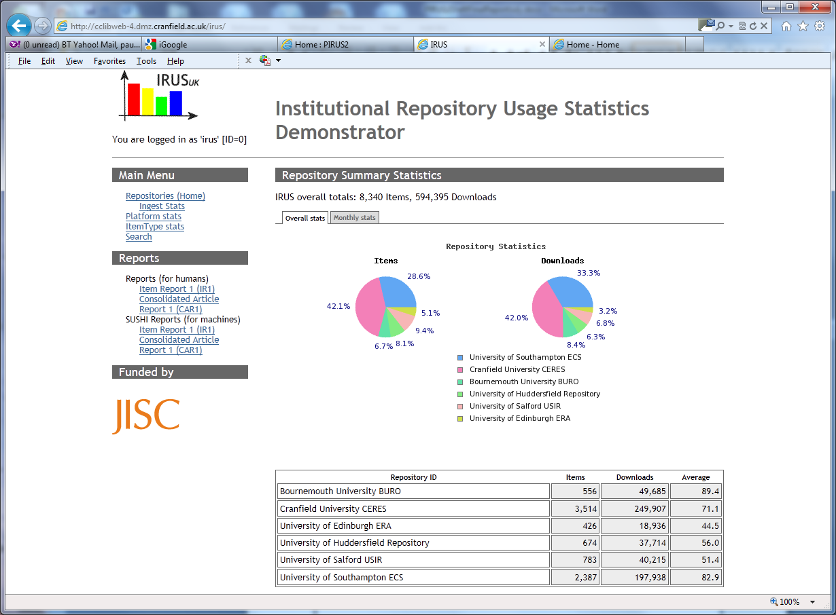
IRUS-UK: showing statistics
IRUS Portal – overall stats
Notes:
Screenshot is from earlier demonstrator
Current portal is in early development stage
Who can see what – still to be decided

Slide 11
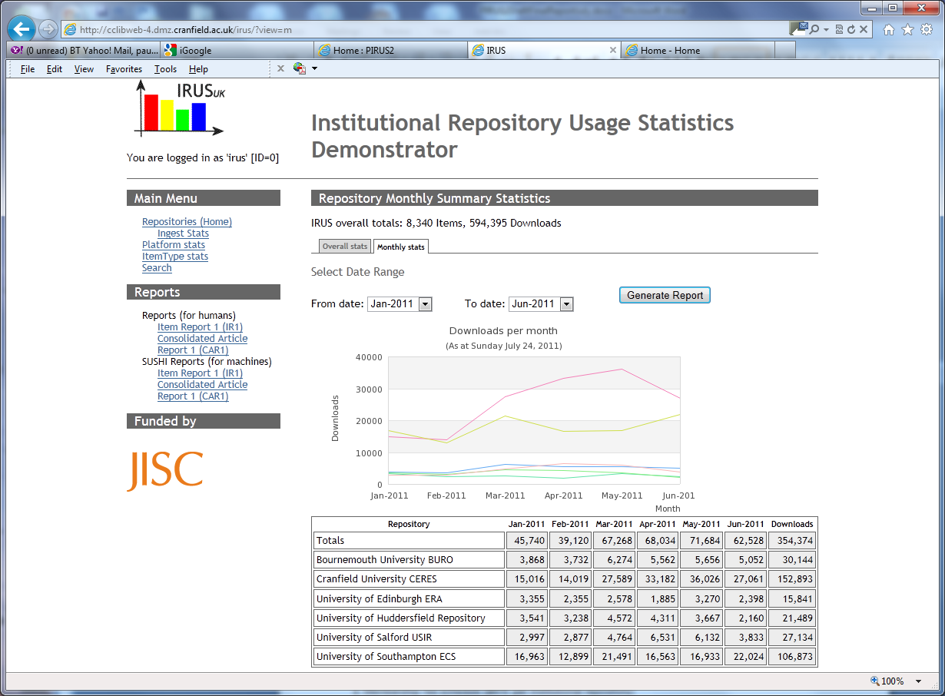
IRUS-UK: showing statistics
IRUS Portal – monthly stats
Notes:
IRUS will also produce daily stats
Further views into the DB – still to be decided

Slide 12
IRUS-UK: getting statistics out
Various reports will be available to Institutions
For humans, downloads as CSV/Excel spreadsheet files
Monthly and daily granularity
For machines, harvesting via SUSHI
Monthly granularity
Usage statistics for incorporation into Repositories
Via an API/Web Service
details yet to be determined

Slide 13
IRUS-UK: where we are now
Pioneers sending data to IRUS
Bournemouth, City, Huddersfield (Eprints)
Cranfield (Dspace)
Others in the pipeline (inc. Leicester, Salford)
We’re working on:
Ingest scripts
Portal UI – basics
Spreading the word about IRUS

Slide 14
IRUS-UK: next steps
More of what we’re already doing…
Community Engagement
Getting more IRs on-board
Defining and evaluating user requirements
including surveys, interviews, monitoring feedback, etc.
Processes to support
institutional liaison, data collection, monitoring and responding to future requirements, ensuring interoperability
development and production environments including monitoring, back-up, authentication and archiving polices and processes
Formal application for COUNTER-compliance

Slide 15
IRUS-UK
Project web site:
http://www.irus.mimas.ac.uk/
Please contact our helpdesk irus@mimas.ac.uk
if you are a UK repository wishing to participate in IRUS
You just want more info…
Thank you!

