Slide 1
Does anyone use the material in your repository?
Institutional Repository Usage Statistics (IRUS) UK
Jo Alcock
Evidence Base, Birmingham City University
July 2014
Notes:
As part of today’s presentation I’ll be giving an overview of the IRUS-UK service, doing a demo of the reports available, and sharing some user feedback.

Slide 2
IRUS-UK
Funded by Jisc
Project Team Members:
Mimas, The University of Manchester – Project & Service Management & Host
Cranfield University - Development
Evidence Base, Birmingham City University – User Engagement & Evaluation
Outcome of PIRUS2 (Publisher and Institutional Repository Usage Statistics)
http://www.cranfieldlibrary.cranfield.ac.uk/pirus2/
Aimed to develop a global standard to enable the recording, reporting and consolidation of online usage statistics for individual journal articles hosted by IRs, Publishers and others
Proved it was *technically feasible*, but (initially) easier without ‘P’
IRUS-UK: Institutional Repository Usage Statistics – UK
Enable UK IRs to share/expose usage statistics based on a global standard – COUNTER
Notes:
IRUS-UK – same team who brought you JUSP
PIRUS2 proved technical feasibility, but highlighted some concerns for (some) Publishers.
Easier to start with IR community.

Slide 3
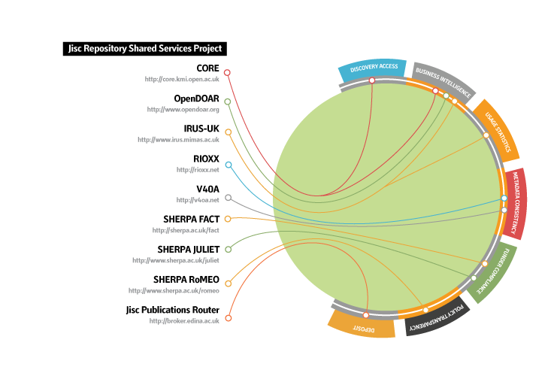
Bringing together key repository services to deliver a connected national infrastructure to support OA
Notes:
This diagram represents the work Jisc is doing to bring together key repository shared services to deliver a connected national infrastructure to support OA.
IRUS is part of a set suite of shared services.
As you can see there are a number of functions that these perform:
Discovery and Access (CORE Aggregation (metadata and full text) and also OpenDOAR provides M2M discovery for repositories and other services)
Business Intelligence (CORE Aggregation, Open DOAR, IRUS UK
Usage Statistics (IRUS UK)
Policy Transparency (SherpaRoMEO
Funder Compliance (Juliet and SherpaFACT)
Metadata consistency – a fundamental part of infrastructure is getting clear what are the common metadata requirements across scholarly systems and implementing work around this (RIOXX Metadata Application Profile and Vocabularies for Open Access (This also support a number functions as mentioned above – discovery, funder compliance, usage statistics.
Interconnectedness - We have also been looking at the Interconnectedness of these services and the opportunity this affords to enhance functionality, to provide service efficiency – for example IRUS harvests download statistics from CORE to present an aggregate view of downloads of an item in a repository as well as from CORE (of that same item) CORE uses OpenDOAR to harvest from OA repositories
Interconnectedness also includes - international use of infrastructure – so we are looking at how our infrastructure could support international requirements – OpenDOAR is already one of those international services and we are looking at how CORE could supply OpenAIRE with data they need for compliance rather than query each UK repository. CORE is also working with OpenDOAR to see how they could supply statistical data to compliment data generated by OpenDOAR.
As part of bringing these shared services together – we are also addressing the sustainability issues – this includes the financial, organisational and technical aspects of their operation.

Slide 4
Support for Integration
Repositories to implement - patches, scripts and plug-ins produced by repository shared services. Support is being planned via:
Repository Support Project (RSP)
Planning co-ordination with platform-specific support through Eprints Services, the DSpace community and Fedora.
Notes:
We are also putting in place a layer of support for IRs through the Repository Support Project (RSP) and planning co-ordination with platform-specific support through Eprints Services, the DSpace community and Fedora.

Slide 5
IRUS-UK: aims & objectives
Collect raw usage data from UK IRs for *all item types* within repositories
Not just articles
Downloads not record views
Process those raw data into COUNTER-compliant statistics
Return those statistics back to the originating repositories for their own use
Give Jisc (and others) a wider picture of the overall use of UK repositories
Offer opportunities for benchmarking/profiling/reporting
Act as an intermediary between UK repositories and other agencies

Slide 6
IRUS-UK: gathering data
Considered 2 scenarios for gathering data
Push: ‘Tracker’ code
Whenever a download occurs the repository ‘pings’ the IRUS-UK server with details about the download
Pull: OAI-PMH harvesting
When a download occurs the details of the event are stored on the local repository server
IRUS-UK periodically harvests the download data (using the OAI-PMH protocol)
Opted for the Push method – ‘Tracker’
Just easier - but minimise data pushed
Patches for Dspace and Plug-in for Eprints
Implementation guidelines for Fedora
Notes:
Drew on expertise of involvement with:
Knowledge Exchange w/shops & recommendations
Drew on:
MESUR project especially (Bollen & van de Sempel)
Kept ‘pushed data’ to minimum
Dspace patches – @Mire, Belgium
ePrints – Tim Brody, Soton
Fedora – coding required at each IR (Ben O’Steen wrote daemon & implemented for Oxford University as part of PIRUS2)

Slide 7
IRUS-UK: the ingest process
The ingest process has been described in detail previously, see : http://www.irus.mimas.ac.uk/news/
The key point is to apply the COUNTER Code of Practice to filter out robots and double clicks
However the COUNTER Robot Exclusion list is specified only as a *minimum requirement* – more can be done
We’ve added additional filters to
Remove more user agents
Apply a simple threshold for ‘overactive’ IP addresses
Substantially better, but we needed a more sophisticated filtering system

Slide 8
IRUS-UK: the ingest process
‘Information Power‘ investigation & report:
Analysed raw data collected since July 2012
Tested the feasibility of devising algorithms to ‘dynamically’ identify unusual usage/robot activity
Suspicious behaviour can’t necessarily be judged on the basis of one day’s usage
Can be almost impossible to distinguish between genuine and non-genuine activity
In each calendar month process logs daily
Eliminate as much as we can with a quick, minimalist approach
Insert statistics into a ‘Provisional Daily Stats’ table
At the end of each month reprocess those provisional stats
Apply more comprehensive, sophisticated filtering
Load the restated stats into the permanent daily stats table
Empty the provisional table ready for the next month

Slide 9
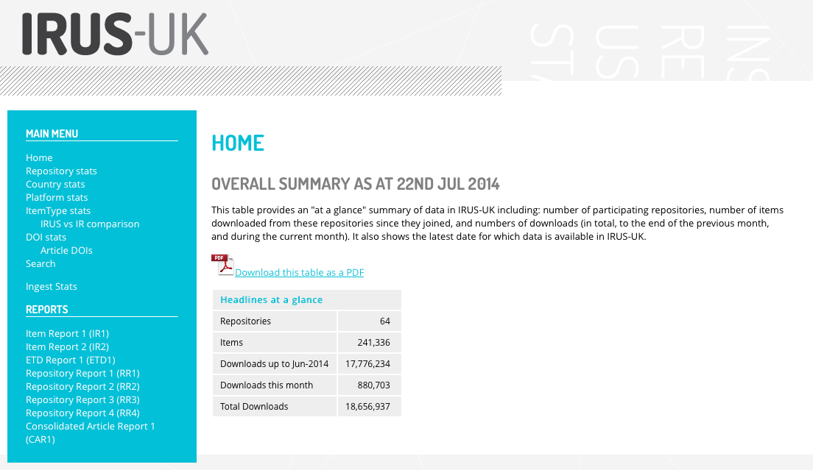
IRUS-UK: Overall Summary
SKIP
Notes:
Overall summary of data in IRUS-UK - number of repositories, items which have recorded a download, and number of downloads across IRUS-UK.

Slide 10
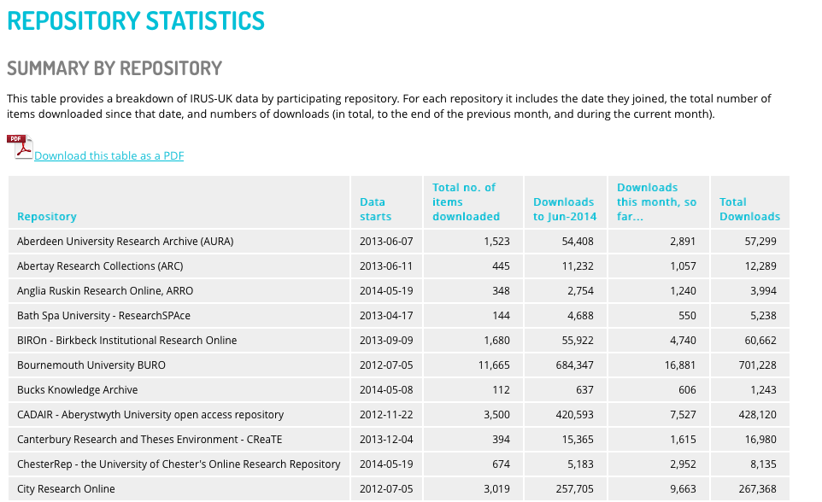
IRUS-UK: Repository Statistics
Notes:
Summary totals by repository - gives start date (when repository joined IRUS-UK), and total number of successful downloads recorded since then.

Slide 11
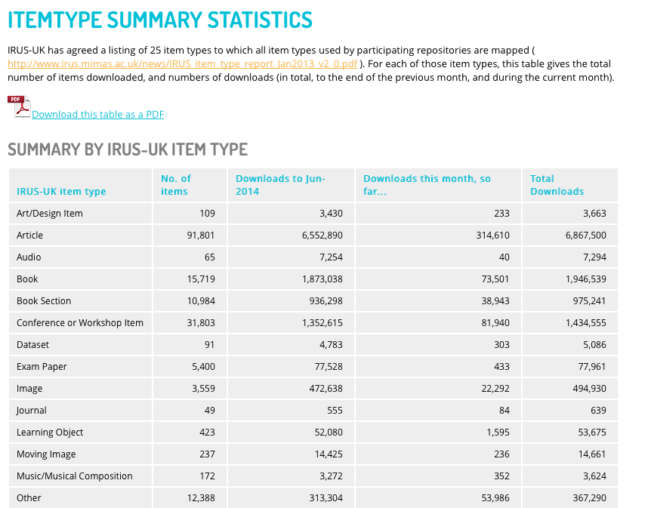
IRUS-UK: ItemType Summary Statistics
Notes:
Summary statistics across IRUS-UK by item type.

Slide 12
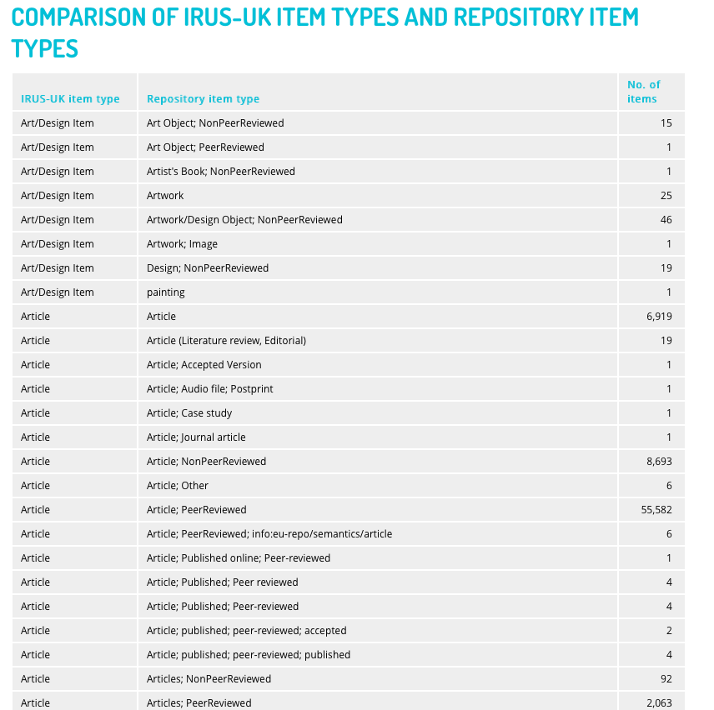
IRUS-UK: Item types mapped to IRUS-UK
Notes:
Comparison of IRUS-UK item types and repository item types (IRUS-UK stores original repository type so if IRUS-UK item types change in future the items can easily be remapped).

Slide 13
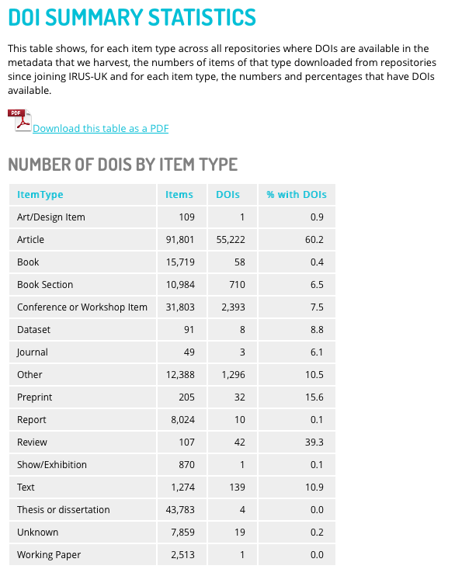
IRUS-UK: DOI Summary Statistics
Notes:
Number of items in each IRUS-UK item type that have been downloaded, and how many of them have DOIs.

Slide 14
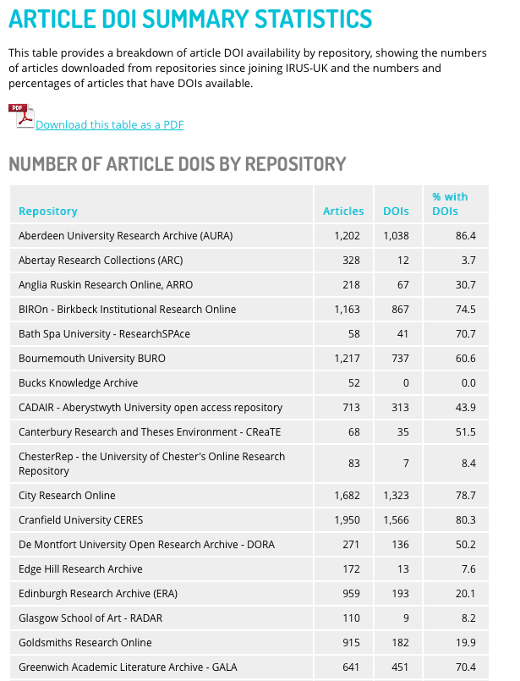
IRUS-UK: Article DOIs by repository
Notes:
Number of *articles* downloaded from each repository since joining IRUS-UK, and how many of them have DOIs.

Slide 15
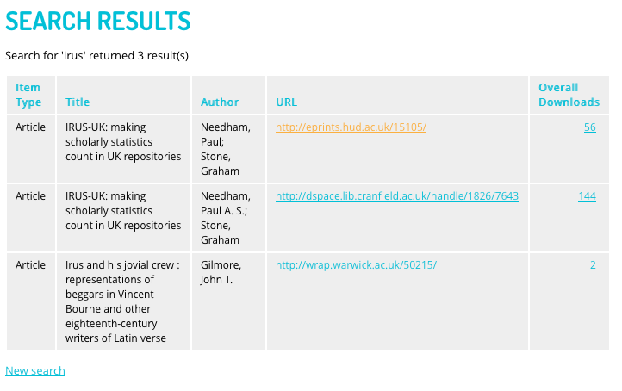
IRUS-UK: Title/Author Search
Notes:
Searching for a particular item - in this a general search for ‘irus’ but could also restrict search to a certain repository or certain item type. Hyperlinked URL takes you to item, hyperlinked download figure takes you to monthly (and daily for last month) usage statistics for item.

Slide 16
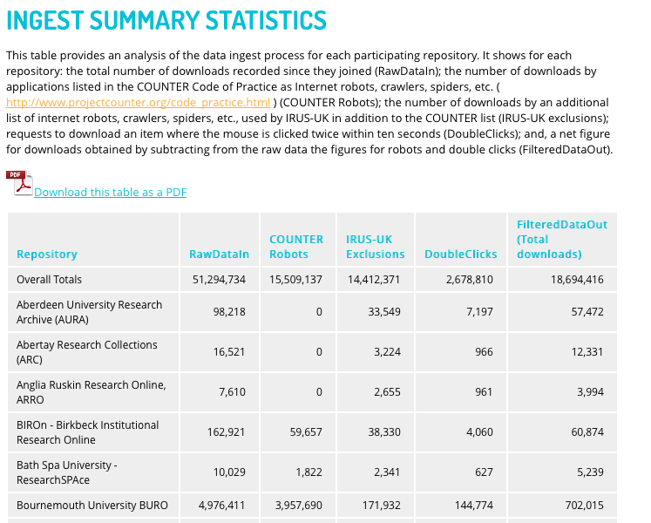
IRUS-UK: Ingest Summary Statistics
Notes:
This shows the ingest summary for each repository - how many downloads have been excluded due to COUNTER robots filtering, IRUS-UK exclusions, and double clicks.

Slide 17
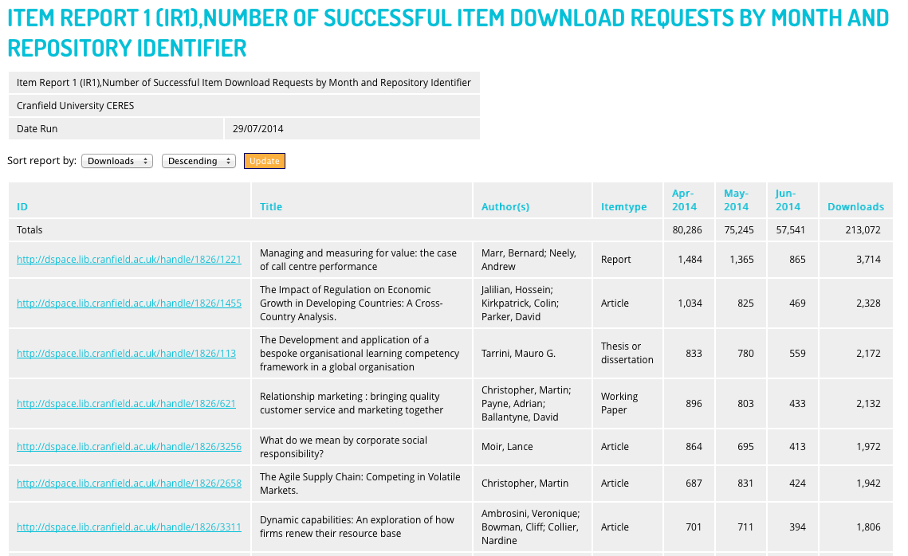
IRUS-UK: IR1 Report
Notes:
Successful items downloads from repository - data displayed monthly totals and sum (relevant months selected in previous screen).

Slide 18
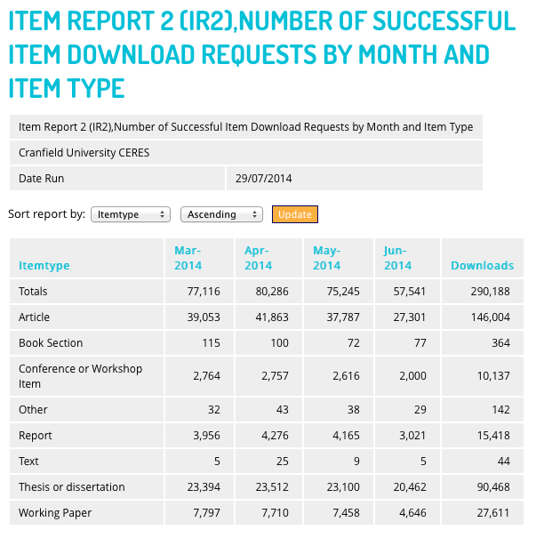
IRUS-UK: IR2 Report
Notes:
Overview of downloads of different item types within repository, presented on a monthly basis. Can sort data by number of downloads.

Slide 19
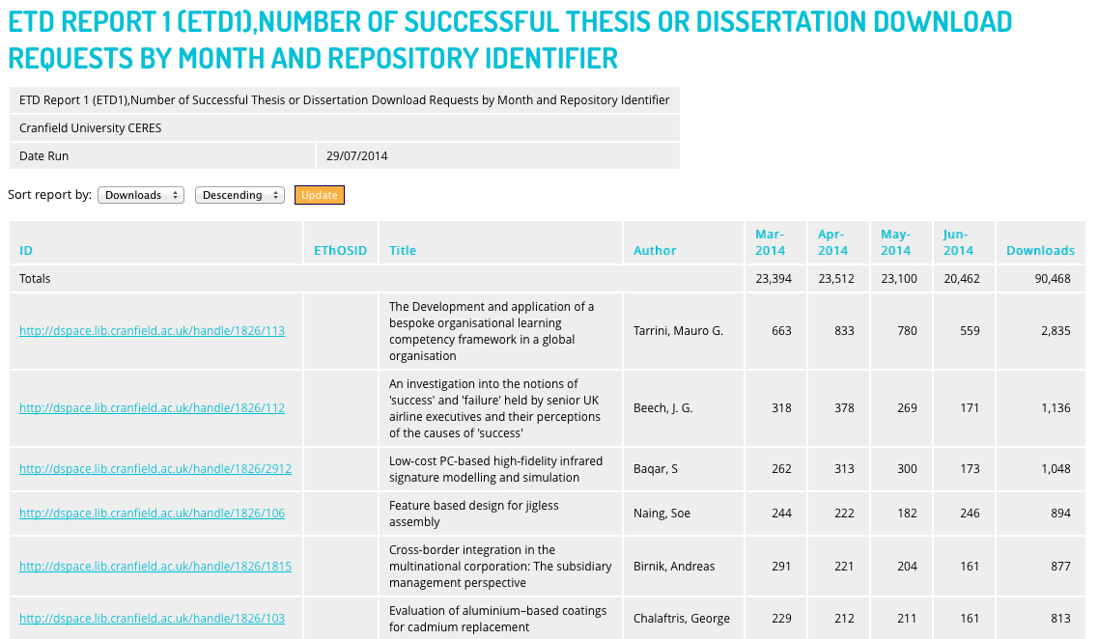
IRUS-UK: ETD1 Report
Notes:
Data just for thesis or dissertation downloads (information from item types mapping).

Slide 20
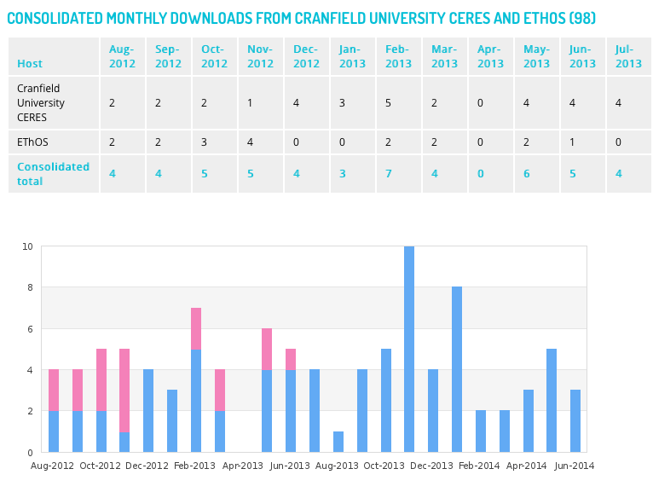
IRUS-UK: ETHoS integration
(currently in development)
Notes:
Search - Robertson, Cranfield, Thesis or dissertation.
The blue bars in the chart represent downloads from the repository, the pink represent downloads from ETHoS.

Slide 21
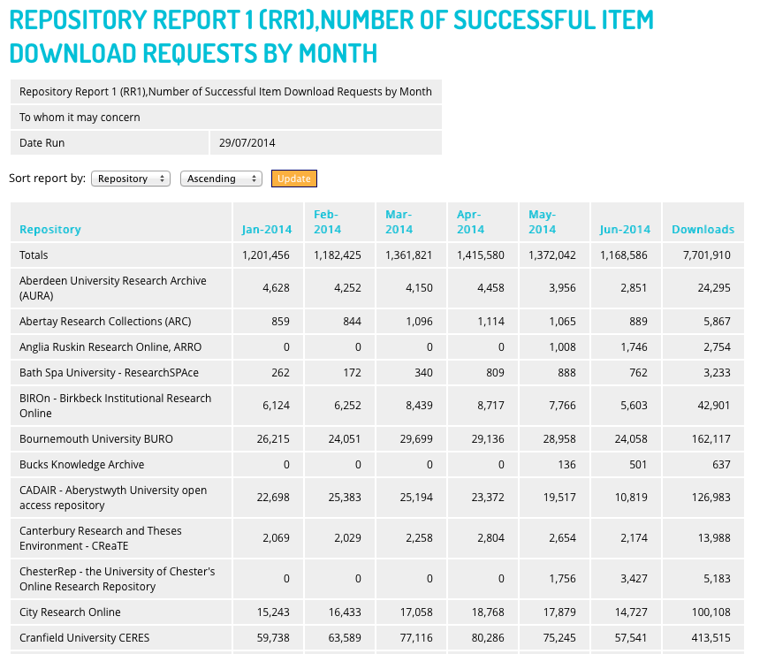
IRUS-UK: Repository Report 1
Notes:
Monthly breakdown of downloads for each repository (can select months in previous screen).

Slide 22
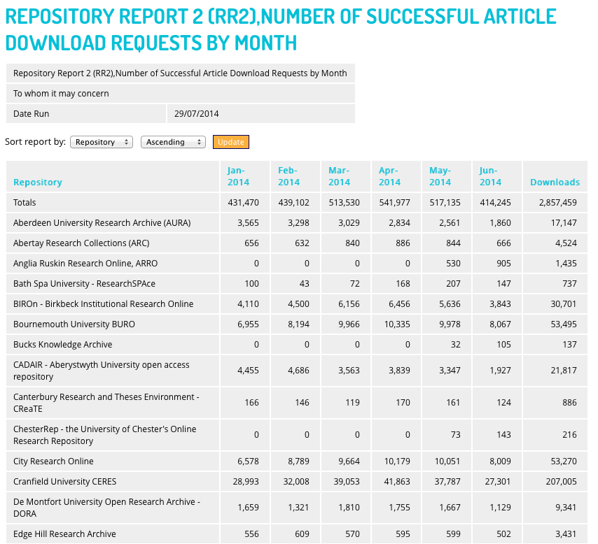
IRUS-UK: Repository Report 2
Notes:
View statistics for specific item types (in this case ‘article’).

Slide 23
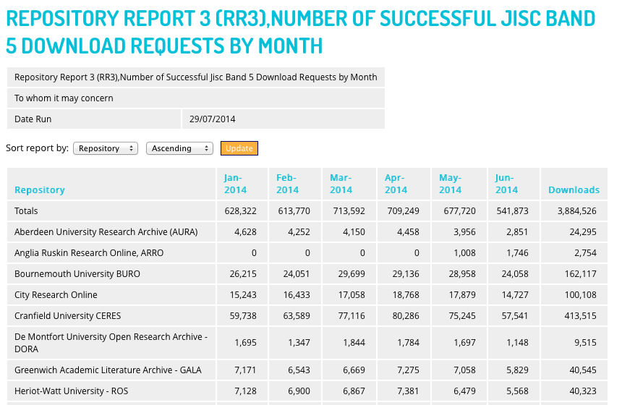
IRUS-UK: Repository Report 3
Notes:
View statistics within Jisc band.

Slide 24
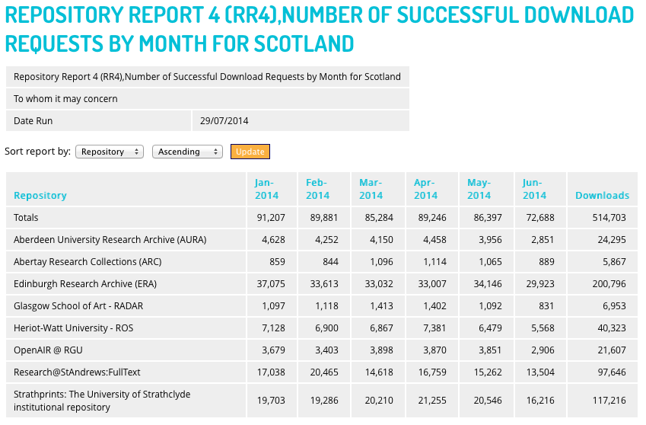
IRUS-UK: Repository Report 4
Notes:
View statistics by country of repository.

Slide 25
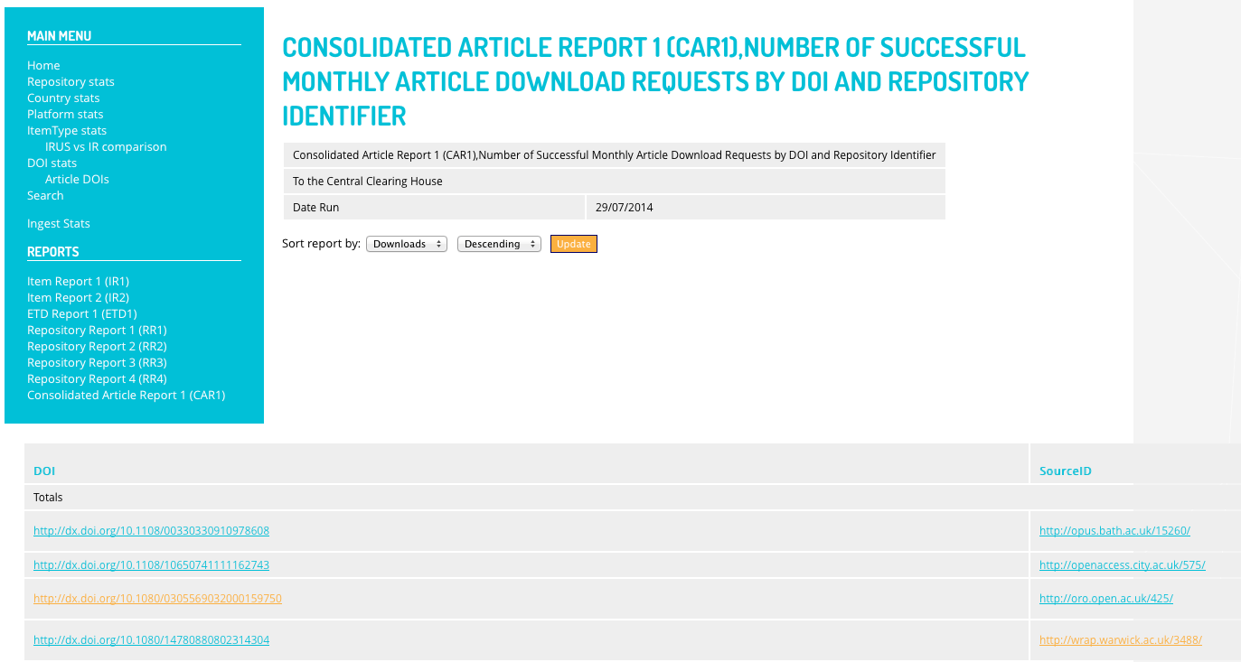
IRUS-UK: CAR1 Report
Notes:
Demonstrates how IRUS-UK data for articles could be combined with publisher data to consolidate usage statistics.

Slide 26
IRUS-UK: Community engagement
Growing number of repositories participating in IRUS-UK – currently 64 repositories
Communication about progress and new developments via number of different channels:
IRUS-UK mailing list
@IRUSNEWS Twitter account
IRUS-UK newsletter
IRUS-UK webinars
Gather feedback from participating repositories via surveys and conversations
Community Advisory Group provide feedback to the IRUS-UK project team and inform future developments

Slide 27
IRUS-UK: Added value
From 2014 IRUS-UK user survey:
68% reported that IRUS-UK has improved statistical reporting
66% reported that IRUS-UK saves time collecting statistics
66% reported that IRUS-UK enables reporting previously unable to do
83% hope to use IRUS-UK for benchmarking

Slide 28
IRUS-UK: Best feature
Reliable, authoritative statistics
COUNTER compliant statistics
Filtering of robots
IR1 used for reporting to SCONUL
Can repurpose for other reporting mechanisms and different audiences
Ability to benchmark against others
Comparison of download statistics across participating IRs
Number (and range across the sector) of participating institutions
Easy to use
Easy to setup and use
User friendly way to get stats
96% find the current user interface clear
96% find the current functionality clear to understand

Slide 29
IRUS-UK: how to join
If you are a UK repository:
Contact us at irus@mimas.ac.uk to register your interest
Answer a few questions on the type of repository you have and the version you are running. IRUS-UK currently available for:
DSpace
1.8.1, 1.8.2, 1.8.3, 3.0, 3.1, 3.2, and 4.1
OpenRepository hosted repositories
Eprints
3.2.x and 3.3.x
Eprints Services hosted repositories
ULCC hosted repositories
Fedora (implementation guidelines available)
Get advice from us on what work will be involved depending on your repository type and version
Implement any changes advised and then see your usage data instantly in IRUS-UK

Slide 30
Contacts & Information
If you wish to contact IRUS-UK:
irus@mimas.ac.uk
@IRUSNEWS
Project web site:
http://irus.mimas.ac.uk/
“The set up was quick and painless, which is always a delight!”
“Consistent collection of statistics without me having to do it!”

