Slide 1
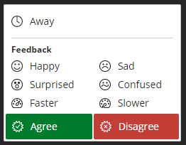
Navigation
Your microphone is muted on entry
We will carry out audio tests every 5 minutes
Click on this icon in the bottom right corner to expand the panel.
Use the icons at the bottom of you screen to:
Use the feedback option to:
Image: opens setting panel
Turn your mic on/off
Turn your camera on/off
Raise your hand if you have a question or want to speak
Tick: opens feedback panel (see below)
Let presenters know how you feel about what they are explaining
Let us know you’ve stepped away

Slide 2
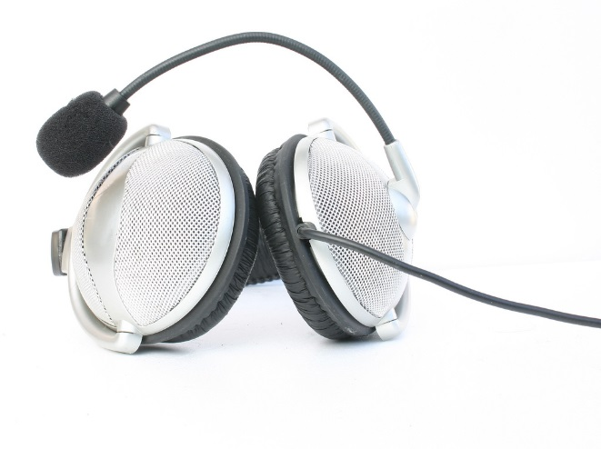
Audio test
Can you hear us?
If so, please raise your hand by clicking on the hand icon in the bottom middle of your screen
If not, please let us know in the chat.
https://www.flickr.com/photos/nihonbunka/46329607/

Slide 3
IRUS-UK service: an introduction
Hilary Jones and Paul Needham
Notes:
Welcome
Introduce self and other team members in the session (others who may sit in)
Ask for questions to go in the chat

Slide 4
Introduction
IRUS-UK is a national aggregation service, enabling UK IRs to share and expose usage statistics at the individual item level, based on a global standard – COUNTER
Collects raw download data from UK IRs for all item types
Processes those raw data into COUNTER-conformant statistics
We have a growing number of participating repositories – currently 141
Notes:
It provides consistent and comprehensive statistics, that are COUNTER-conformant, presenting opportunities for benchmarking at a national level.
IRUS-UK provides standards-based, reliable repository statistics, allowing reporting to institutional managers and researchers, analysing trends over time, benchmarking against other IRs and supporting advocacy. It enables UK IRs to share and expose usage statistics at the individual item level, based on a global standard.
We display the data in a single user-friendly interface.
All participating IRs have agreed that their data is available to view for them and all the other participants, to anyone with Shibboleth login details. You do not need to register for a separate login and password.

Slide 5
Jisc OA services through an article lifecycle
Submission
Acceptance
Publication
Use
Select Journal
Check compliance
Manage costs
Deposit in repository
Report on compliance
Maximise impact
Record impact
Research publication lifecycle
Report
SHERPA RoMEO
SHERPA Fact
Monitor UK
Publications Router
Monitor local
IRUS-UK
Jisc services
SHERPA JULIET
SHERPA REF
Jisc collections
OpenDOAR
CORE
RIOXX
Guidance, consultancy, technical support, and OA good practice
Notes:
It brings together key repository services to deliver a connected national infrastructure to support OA

Slide 6
Gathering data
Simple method to gather raw download data:
On download, message sent to IRUS-UK server with some basic details about that download
Accomplished by adding a small piece of code to repository software, which employs our ‘tracker protocol’
http://irus.mimas.ac.uk/support/toolbox/
Pushes minimal raw download metadata to a third-party server as OpenURL querystrings
Patches for DSpace (4.x, 5.x or 6.x), plug-ins for EPrints (3.2-3.3.x)
Pure portal (5.6.3 or greater)
Fedora and Worktribe

Slide 7
Processing data
Adhere to the processing rules specified in:
Release 4 of the COUNTER Code of Practice for e-Resources
Release 1 of the COUNTER Code of Practice for Articles
i.e. we filter out robot accesses and double clicks on the same basis as scholarly publishers
The COUNTER robot exclusion list is specified only as a *minimum requirement*:
Supplemented COUNTER Codes of practice, adding filters to:
Remove more user agents
Apply a simple threshold for ‘overactive’ IP addresses
Commissioned Information Power to:
Analyse raw data collected by IRUS-UK
Test the feasibility of algorithms to ‘dynamically’ identify and filter out unusual usage/robot activity
Report available from http://irus.mimas.ac.uk/activities/servicereports/
COUNTER Working Group on Robots formed

Slide 8
Exposing statistics
Web User Interface - The IRUS-UK portal
Access currently behind Shibboleth authentication/authorisation
Wide range of views, – slicing and dicing stats from the IRUS-UK database
Reports available for download as CSV/Excel spreadsheet files
Altmetric donuts for individual items ☺
SUSHI service
Standard client/server web service, utilizing a SOAP request/response to retrieve the XML version of COUNTER or COUNTER-like reports
SUSHI Lite API
Under development by the NISO SUSHI Lite Technical Report Working Group (http://www.niso.org/workrooms/sushi/sushi_lite/)
RESTful: uses standard HTTP GET returning JSON
Allows retrieval of stats snippets to be embedded into Repository (and other) web pages

Slide 9
IRUS-UK and GDPR
Jisc Information Strategy team
In advance of 25th of May
As a Jisc service we have had talks with them and they are satisfied with our compliance
IRUS-UK have asked for further investigation into this and assurance
IRUS-UK service
Contact information – only hold name and address whilst they are current
IP addresses – we only use these to identify and eliminate robotic and rogue usage from the statistics we produce
IRs are the data controllers, we are the data processors
Refer to the privacy notice on our website: http://irus.mimas.ac.uk/privacy/

Slide 10
Demo of the portal

Slide 11
Engagement and user support
Engagement
Community Advisory Group (CAG)
Made up of the IRUS-UK team and participants from across the UK using various platforms
Communication
An IRUS-UK mailing list, @IRUSNEWS Twitter account
Activities
Articles, blogs, newsletters, presentations etc.
Support
Case studies, use cases, FAQs and more
All available from the IRUS-UK website: http://irus.mimas.ac.uk/
Notes:
The developments of IRUS-UK are informed through a variety of routes with particular input from our CAG. We also run an annual survey and feed suggestions into our development plans.
CAG: a wide range of users, representing IRs using various platforms.
We keep users informed of progress and developments through different channels.
Activities: Here you can find all the articles, blog posts, newsletters we have written and more
We have a support area of our website: includes support materials: case studies; use cases; (showing how participating IRs are using the IRUS-UK data and showing which reports were used); as well as FAQs; a glossary; and a description of all the statistics and reports available from our portal;

Slide 12
Next developments
Visualisations - Tableau
COUNTER R5
Enhanced metadata
ORCIDs
Funder details
Pilot services
Notes:
Visualisations: including yearly and monthly downloads, downloads by type, by country, yearly trends and ingest statistics by year, month and day

Slide 13
How to join
If you are a UK repository:
Contact us at help@jisc.ac.uk to register your interest
Answer a few questions on the type of repository you have
Get support and advice from us on the work involved, depending on the platform and version you use
See your usage data instantly in IRUS-UK
Notes:
Joining and/or summary

Slide 14
Contact us
IRUS team
Email central helpdesk:
help@jisc.ac.uk
Mention IRUS in subject line

Slide 15
Any questions?

Slide 16
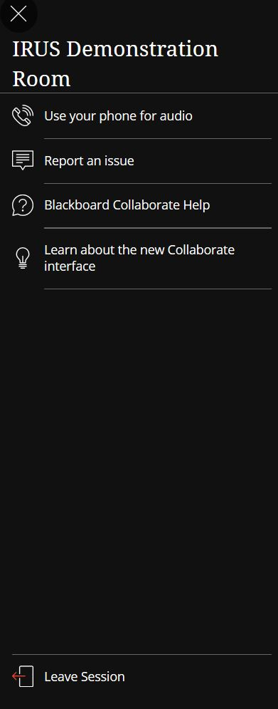
To exit:
Open session menu in the top left
Leave session

